Slide 1
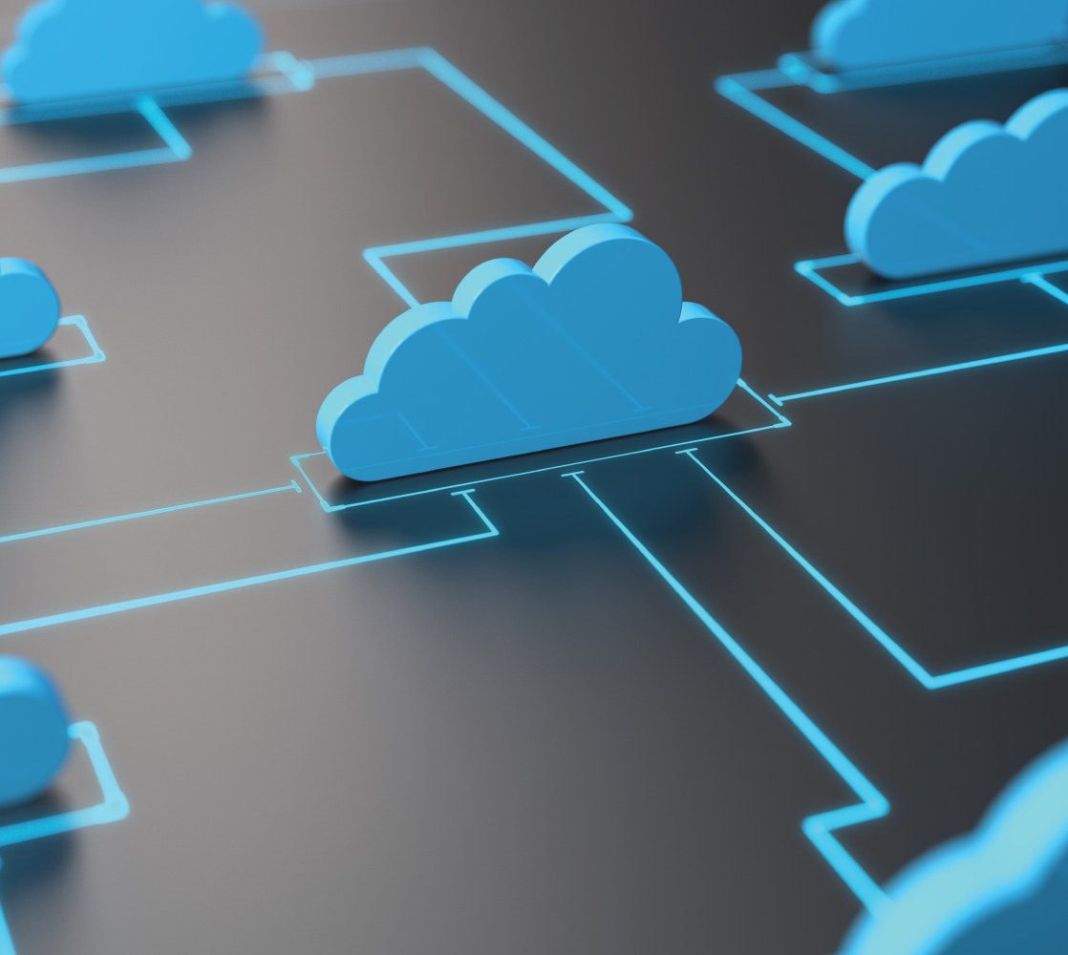
Cloud Service Models – 6W’s
Sarathkumar MC

Slide 2
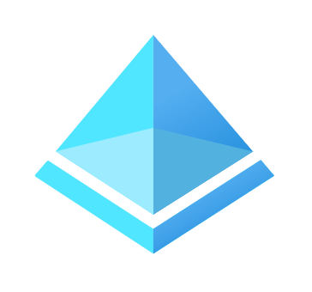
IAM
Senior Consultant @Infosys
Specialized in Cloud Security
7x Azure Certified
linkedin.com/in/mcsarathkumar

Slide 3
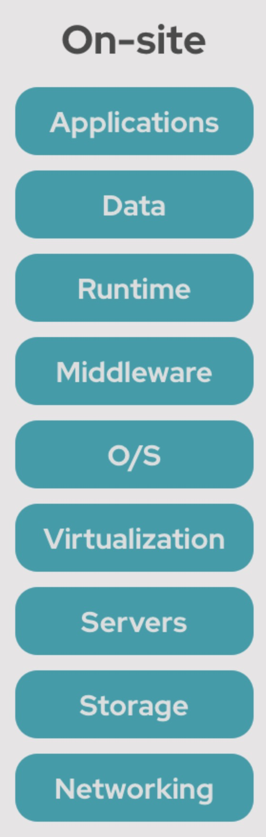
On Premise

Slide 4
3 Core Pillars of Cloud
Compute
Networking
Storage

Slide 5
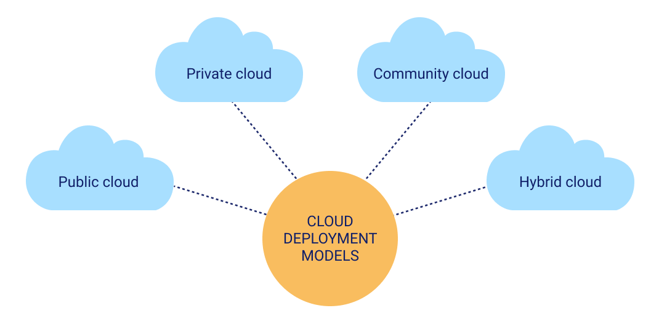
Cloud Deployment Models
Notes:
Community cloud computing refers to a shared cloud computing service environment that is targeted to a limited set of organizations or employees (such as banks or heads of trading firms).

Slide 6

Shared Responsibility Model

Slide 7
Shared Responsibility Model
Cloud Service Provider (CSP)
Responsibility OF the Cloud
Customer
Responsibility IN the Cloud

Slide 8
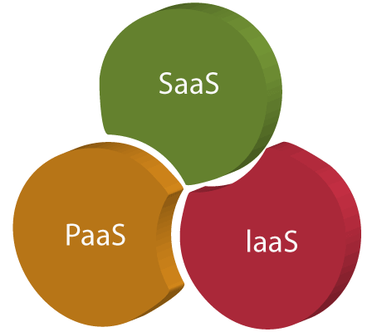
Cloud Service Models

Slide 9
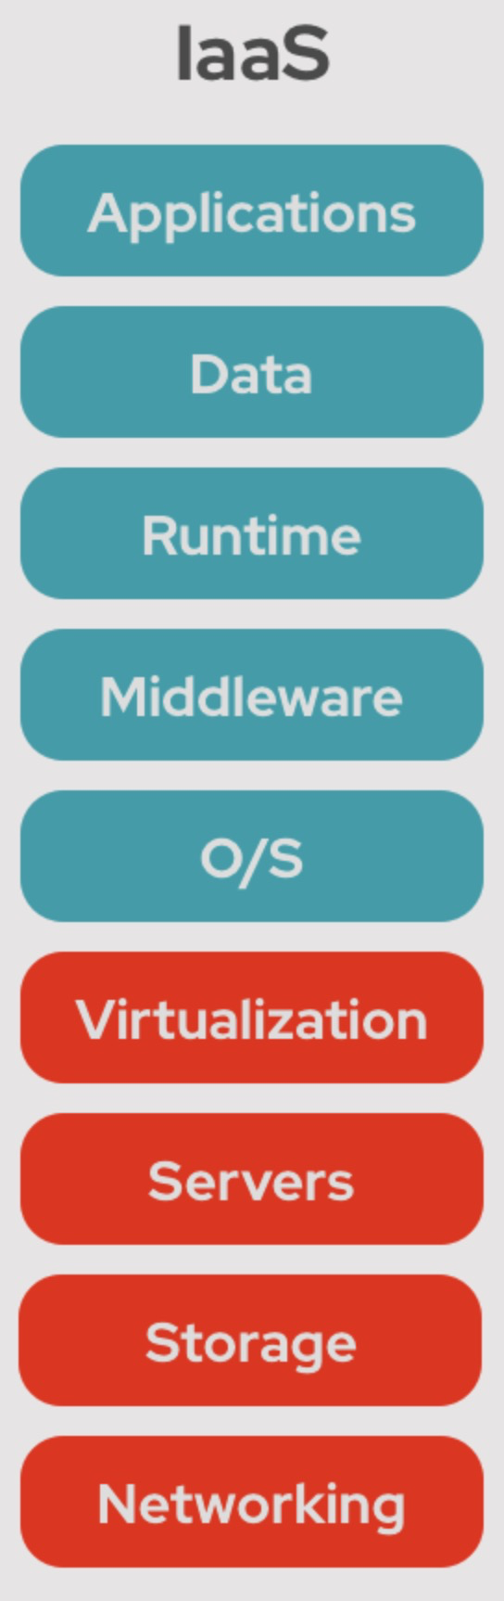
Infrastructure as a Service - IaaS
What: Cloud computing model that offers virtual compute resource over the internet.
Who: Teams who require virtual compute resources.
Where: Provided by cloud service providers (CSPs) that operate data centres globally.
When: Fine grained configurations or dependencies are required
Why: Greater flexibility and control over the underlying infrastructure
How: Users access IaaS resources through a web-based interface or API provided by the CSP, provisioning and managing virtualized resources remotely.

Slide 10
IaaS - Examples
Microsoft Azure Virtual Machines
Amazon Web Services (AWS) EC2 (Elastic Compute Cloud)
Google Cloud Compute Engine

Slide 11
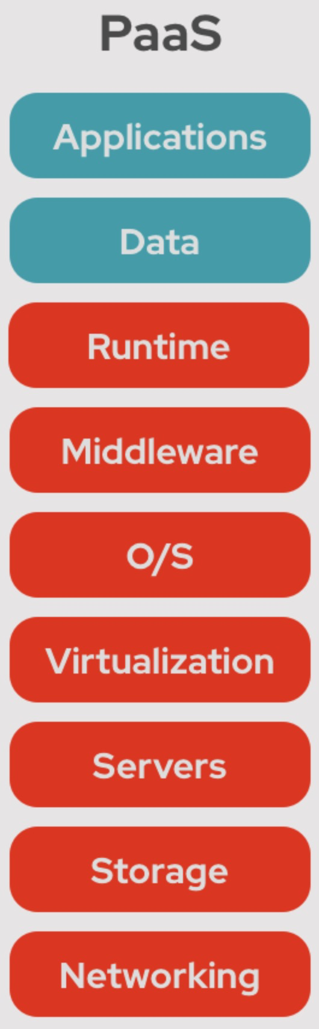
Platform as a Service - PaaS
What: Tools and services for developing, deploying, and managing applications
Who: Teams who focus on application development and deployment
Where: Applications that can be developed, tested, and deployed on a cloud platform.
When: Rapid application development, efficient deployment, and scalability
Why: Simplify application development and deployment process, improve productivity, and reduce operational overheads.
How: Web-based interfaces or APIs.
Notes:
Without the need for managing infrastructure.

Slide 12
PaaS - Examples
Azure App Service: Web applications.
Azure Logic Apps: Workflows
Azure SQL Database: Managed relational database
Azure Cosmos DB: Managed NoSQL
Azure Functions: Serverless compute
Notes:
Azure Logic Apps: Create and run workflows that integrate with various services and systems to automate business processes.
Azure Functions: Event-driven code in response to triggers such as HTTP requests, timers, and message queues.

Slide 13
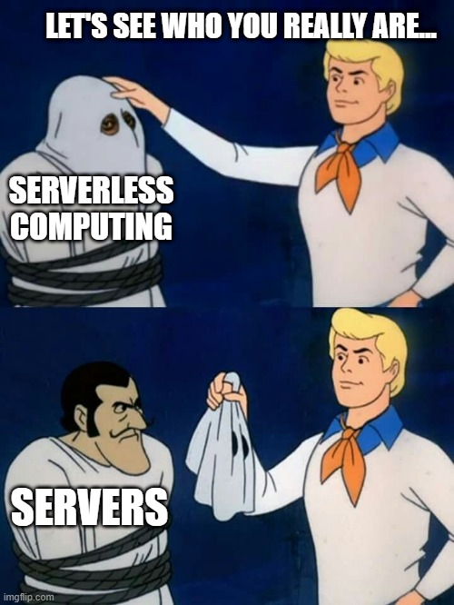
Serverless Compute ?

Slide 14
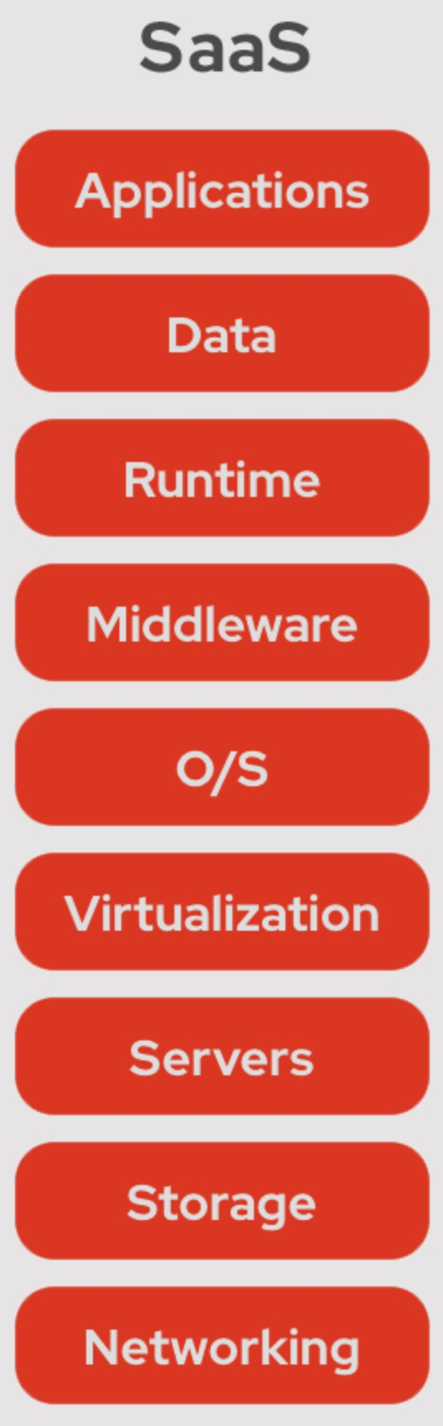
Software as a Service - SaaS
What: Software over the internet
Why: Cost-effective and scalable access to Software
When: Easy access to applications from anywhere, on any device
Where: Hosted and delivered from the cloud
Who: Businesses, organizations, and individuals
How: Typically accessed through a subscription-based model
Notes:
What: No need for local installation/maintenance.
Why: Software without the need for upfront investments in hardware, software, and infrastructure.
When: and want to avoid the hassle of software installation, updates, and maintenance.
Where: Typically accessed through web browsers or mobile apps.
Who: Who needs access to software applications for various purposes, such as productivity, communication, collaboration, and more.
How: Where users pay for the usage of the software and access it over the internet without the need for local installations or updates.

Slide 15
SaaS - Examples
Microsoft Office 365
Azure Active Directory
Microsoft Teams
Microsoft Power BI
Microsoft Defender for Cloud
Notes:
Azure Logic Apps: Create and run workflows that integrate with various services and systems to automate business processes.
Azure Functions: Event-driven code in response to triggers such as HTTP requests, timers, and message queues.

Slide 16
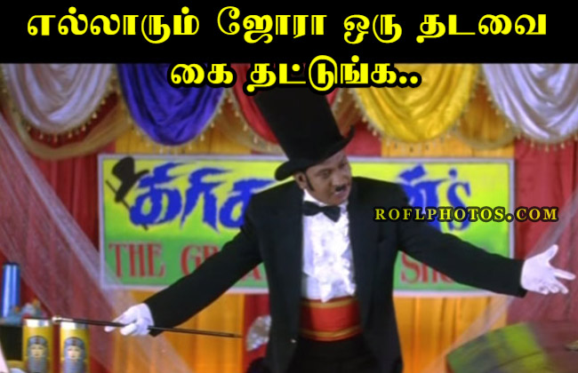
DEMO TIME

Slide 17
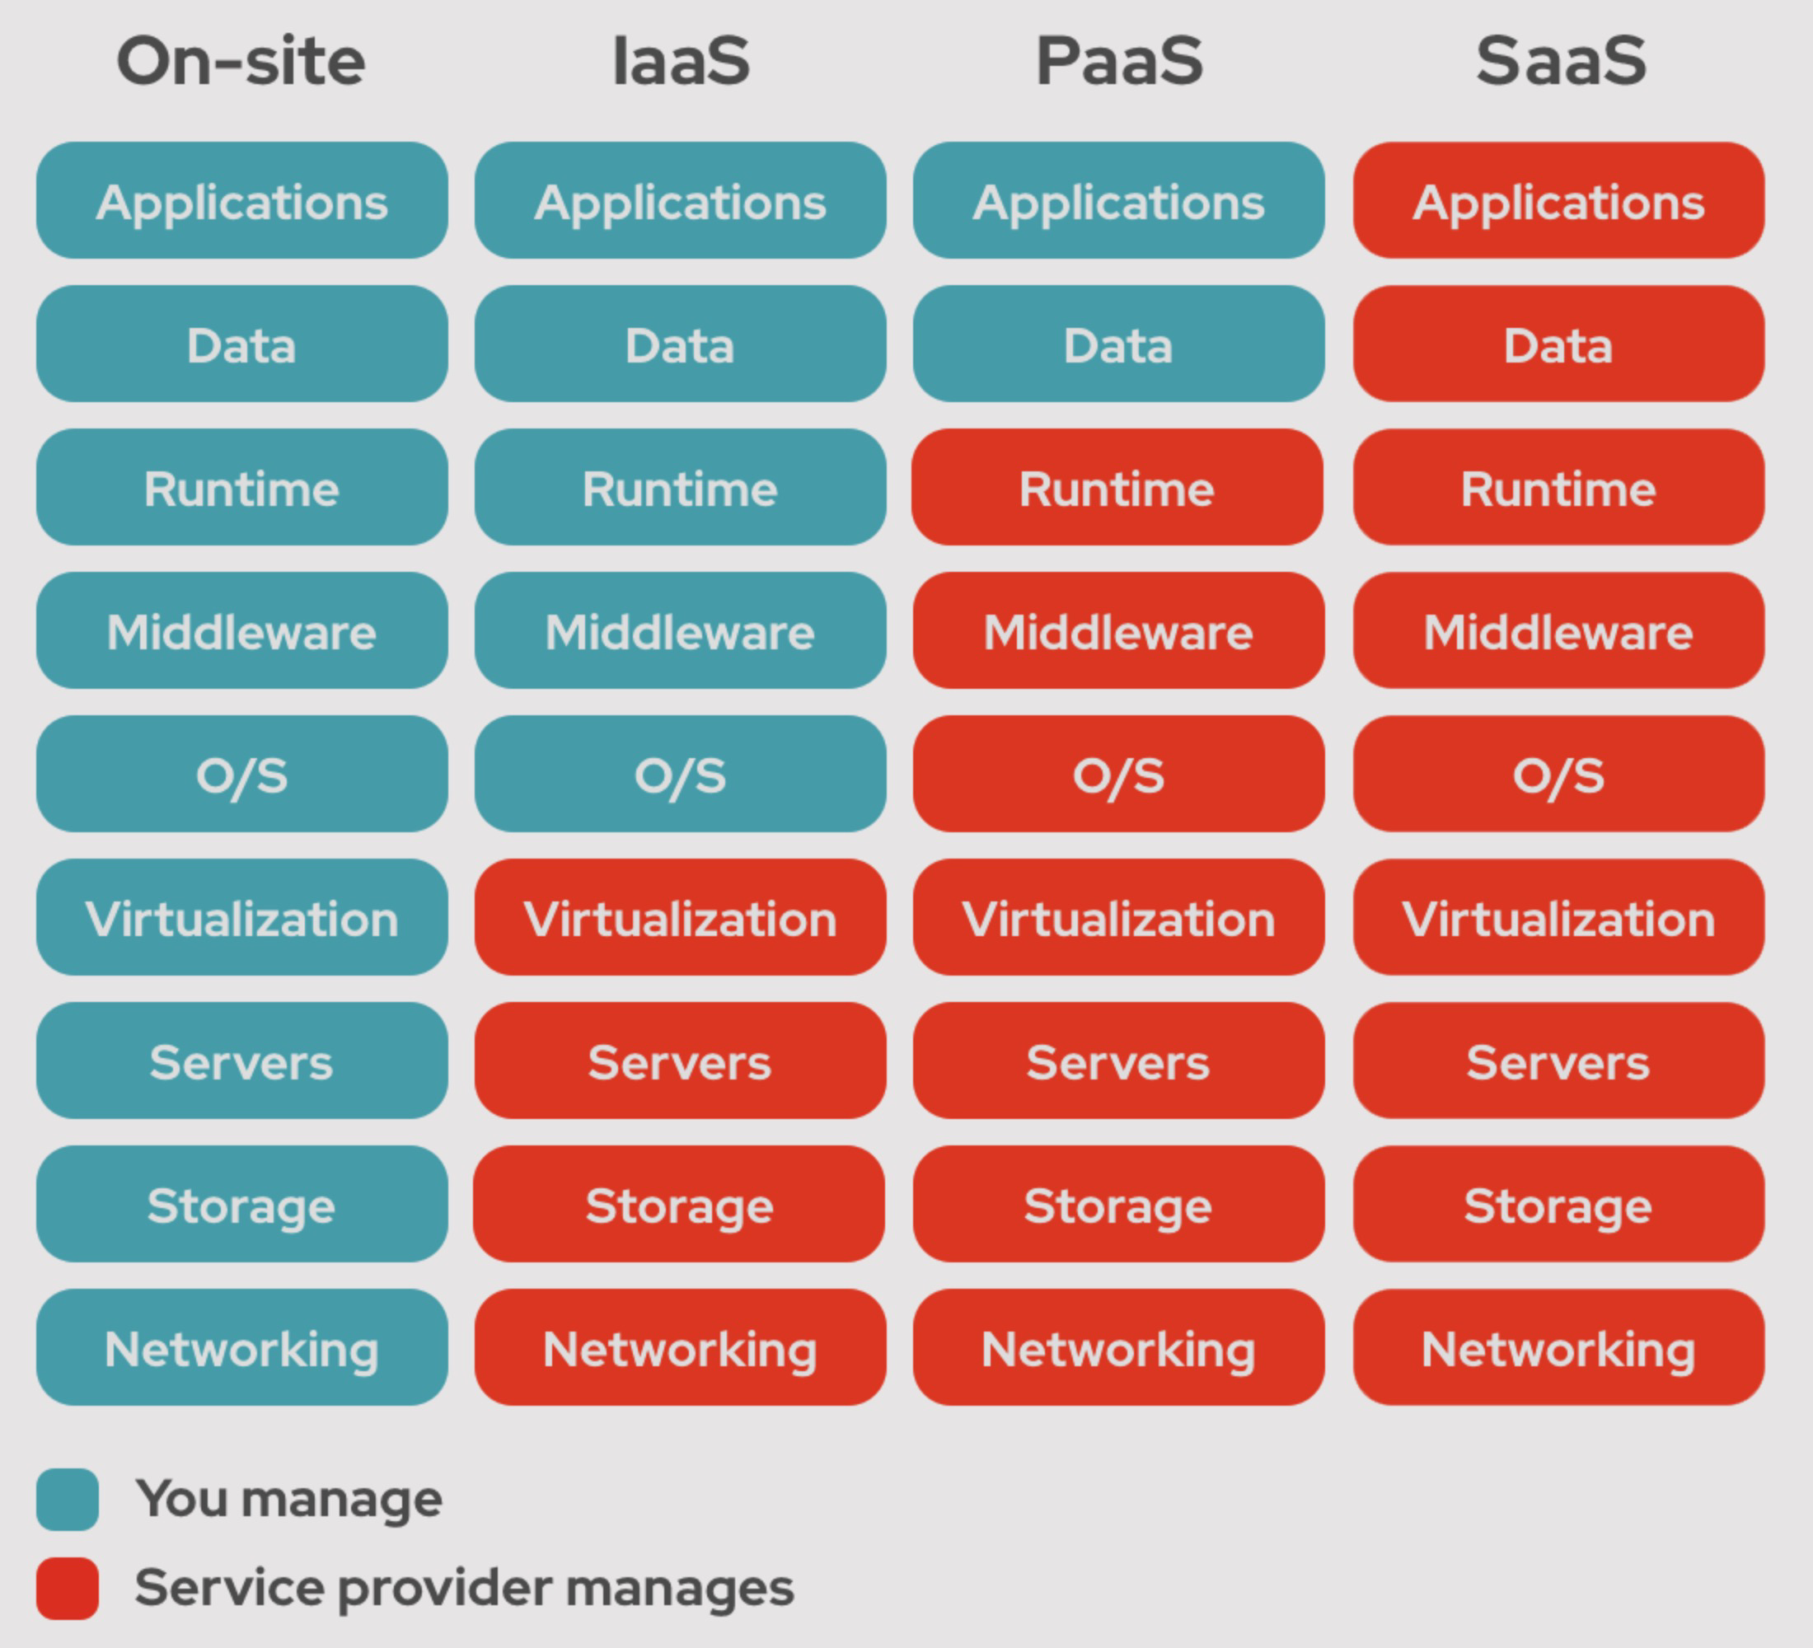

Slide 18
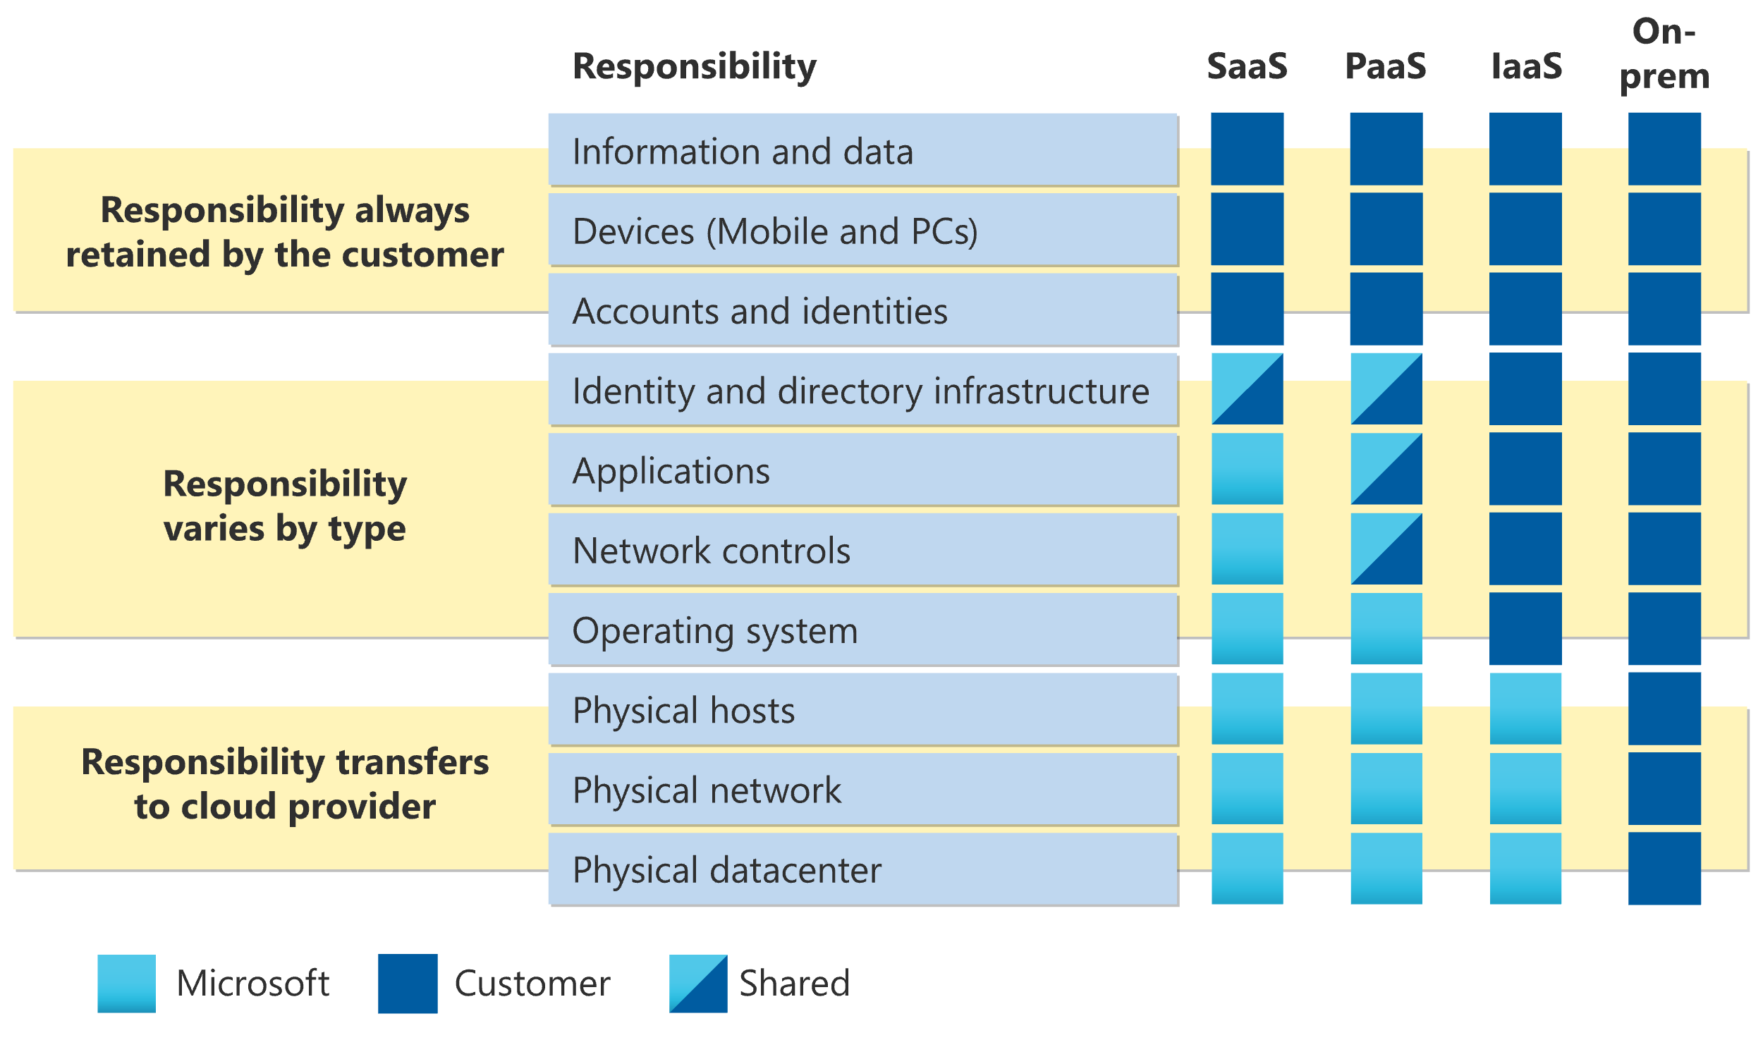
Division of responsibility

Slide 19
Cons of IaaS
More management and maintenance efforts
Patching, backups, and disaster recovery
Higher learning curve and technical expertise for setup, configuration, and management.
Upfront costs for infrastructure and resources

Slide 20
Cons of PaaS
Limited control over infrastructure
Restrictions on certain programming languages, frameworks, or tools
May have limitations on scalability or resource allocation

Slide 21
Cons of SaaS
Limited customizations and flexibility
Dependency on the provider's updates and patches for security
Concerns about data privacy and compliance.
Data portability or vendor lock-in
Challenging to switch providers or migrate data.

Slide 22
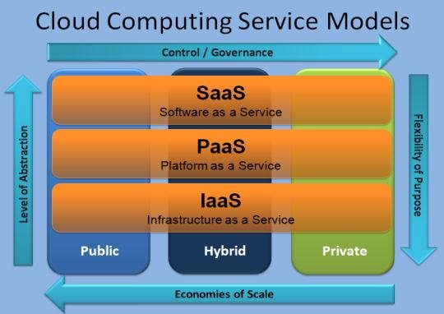

Slide 23
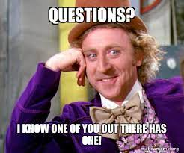
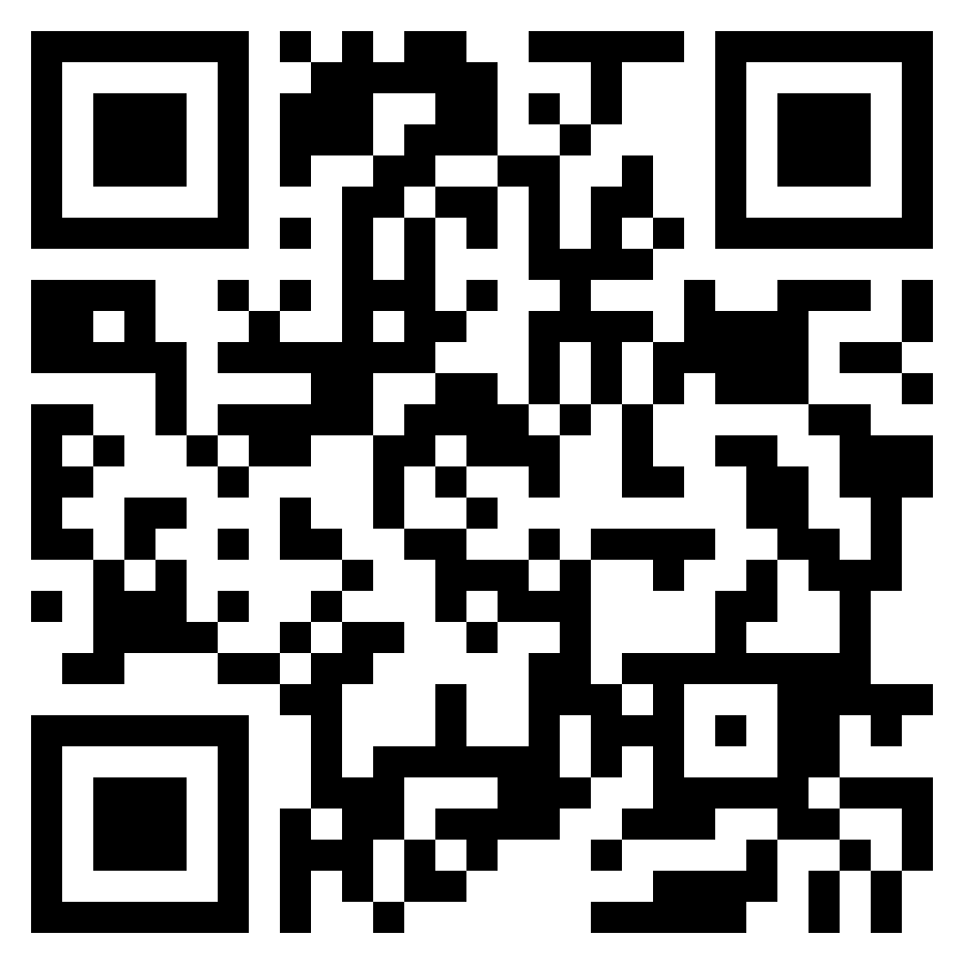

Slide 24


